Slide 1
Major Revision 2 Texas Precipitation Gradient (2017)
Major Revision 2 requested by PeerJ
By Sean Kinard

Slide 2
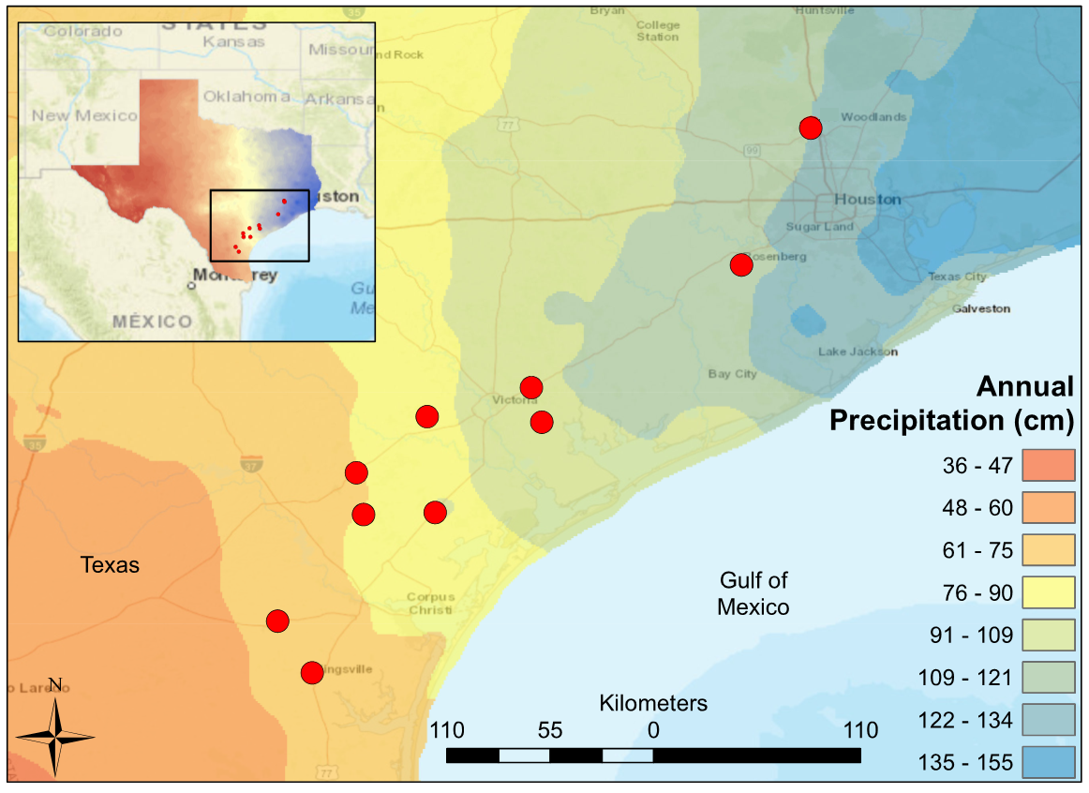
Figure 1: Map of South-Central Texas, where 10 USGS gauged streams were sampled in the spring of 2017. An annual precipitation overlay indicates that sample sites spanned a gradient from 61 cm/yr in the Southwest to 134 cm/yr in the Northeast.

Slide 3
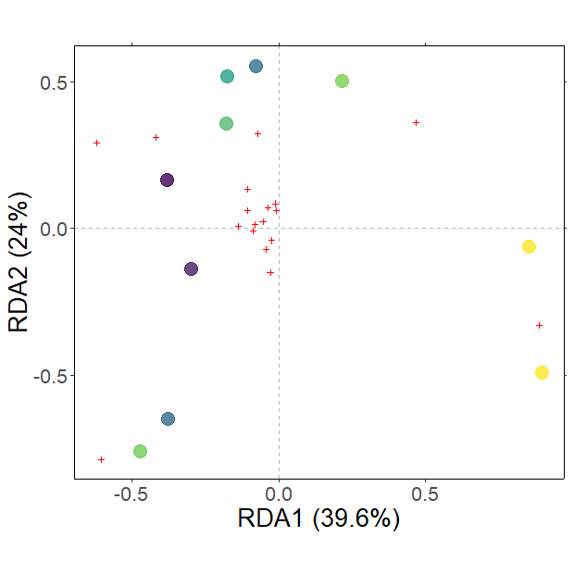
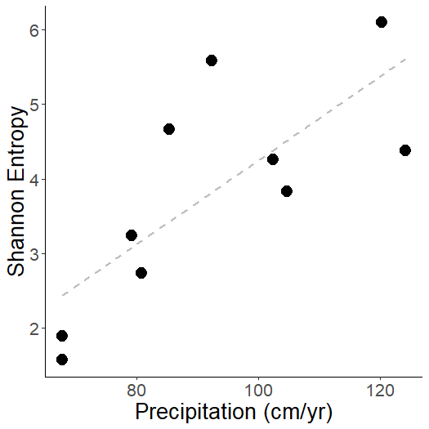
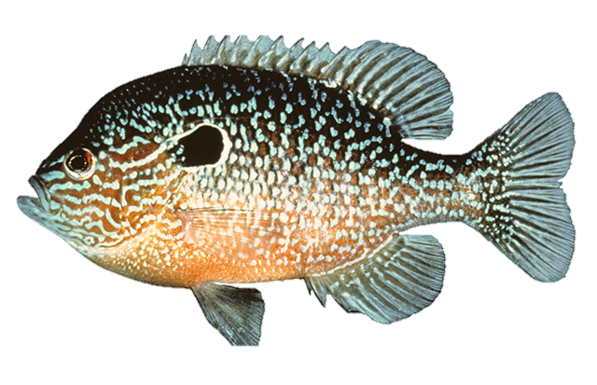
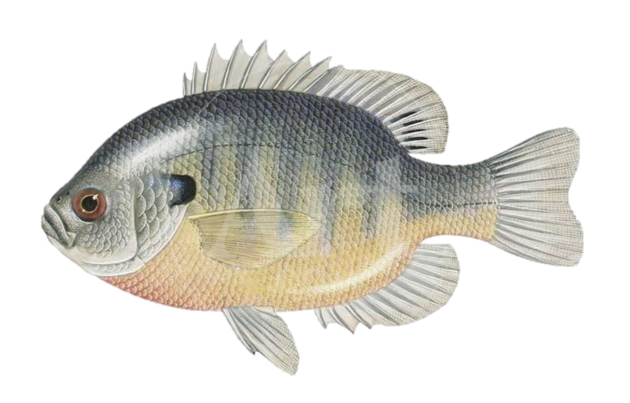
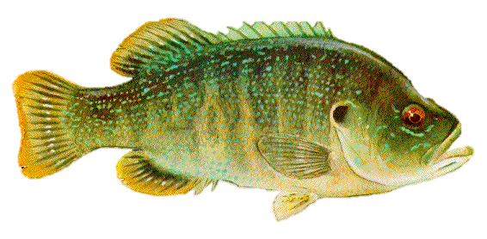
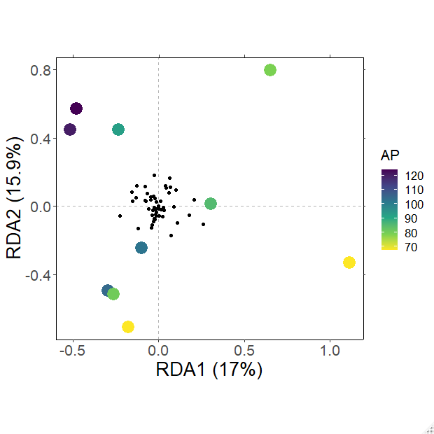
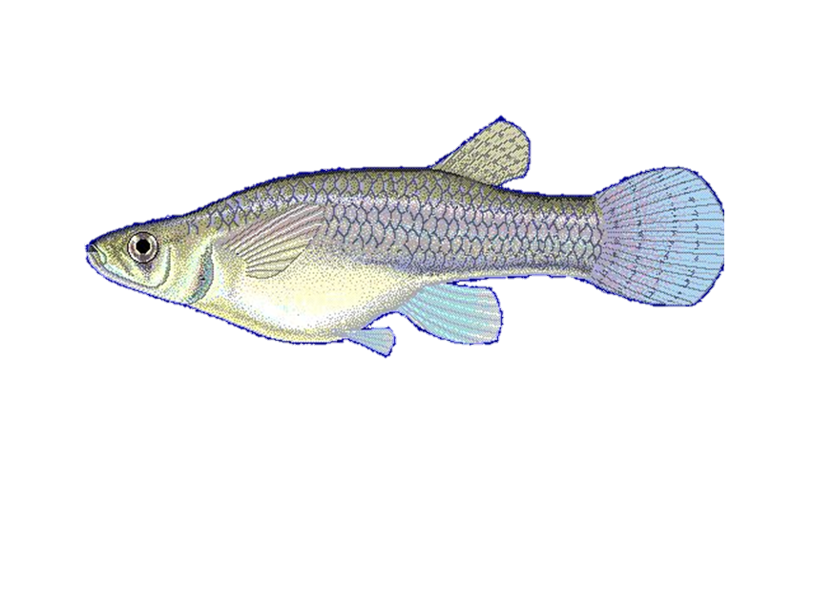
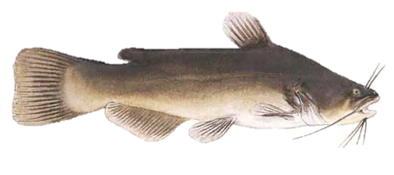
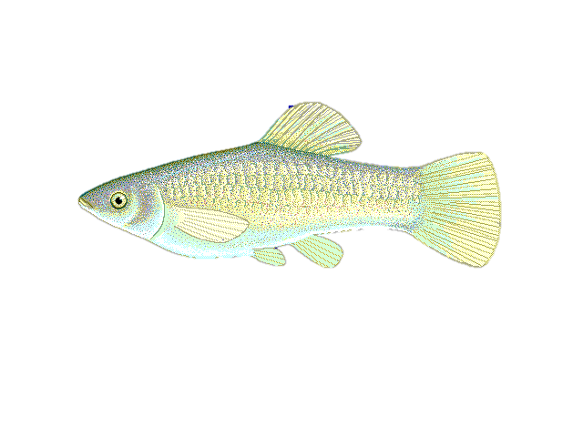
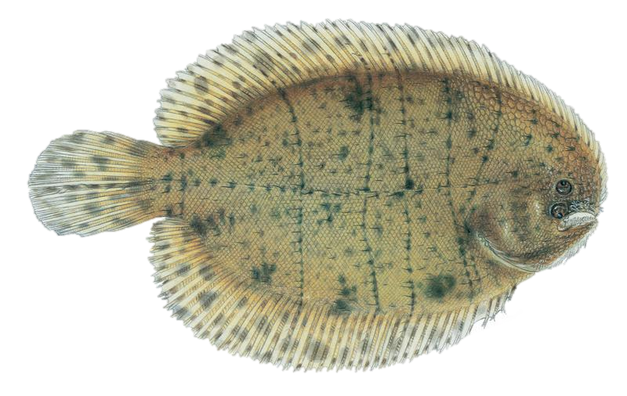
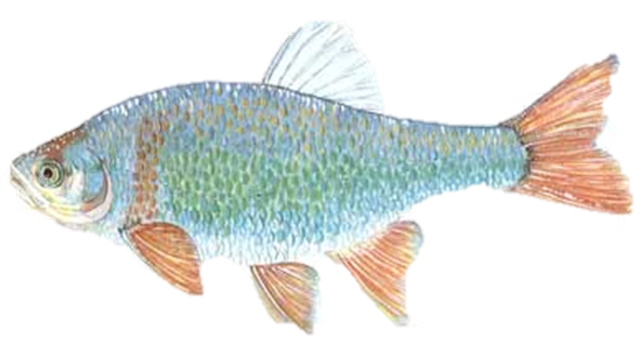
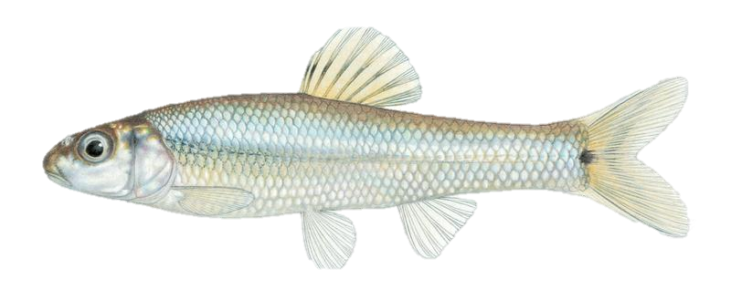
A
B
Precipitation
(cm/yr)
L. megalotis
L. macrochirus
L. cyanellus
Channel Shape
G. affinis
Precipitation
Flashiness
Conductivity
NH₄⁺
Low Flow Pulse %
P. latipinna
A. amierus
C. lutrensis
R² = 0.755
p = 0.002
T. maculatus
P. vigilax
Figure 2. (A) Fish Shannon-Hill diversity plotted against annual precipitation (cm/yr) (B) Fish community ordination using Hellinger transformation and redundancy analysis. Axes labels display the proportion of the variance explained as a percentage. Sites are represented by circles colored by annual precipitation indicated in the legend. Species are represented by red crosses, with species labels and reference images added to outer members. Environmental variables are shown in arrows and the significant ones are presented in red.

Slide 4
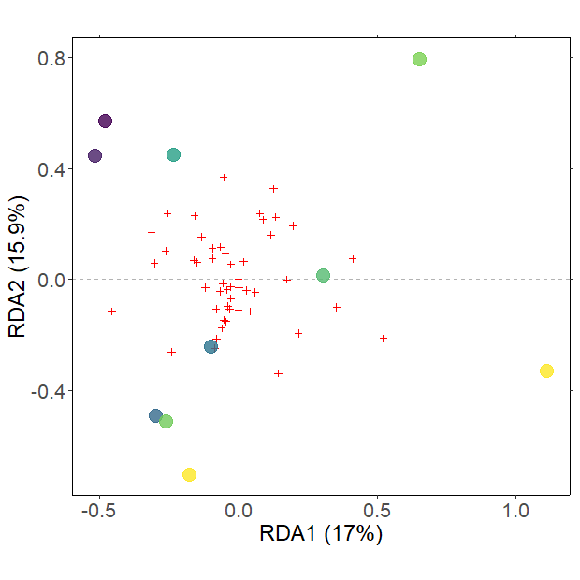
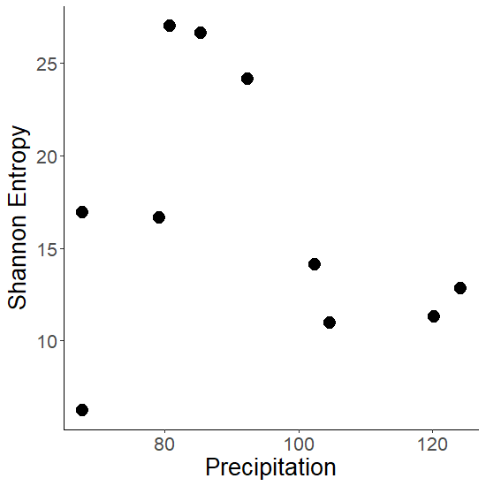
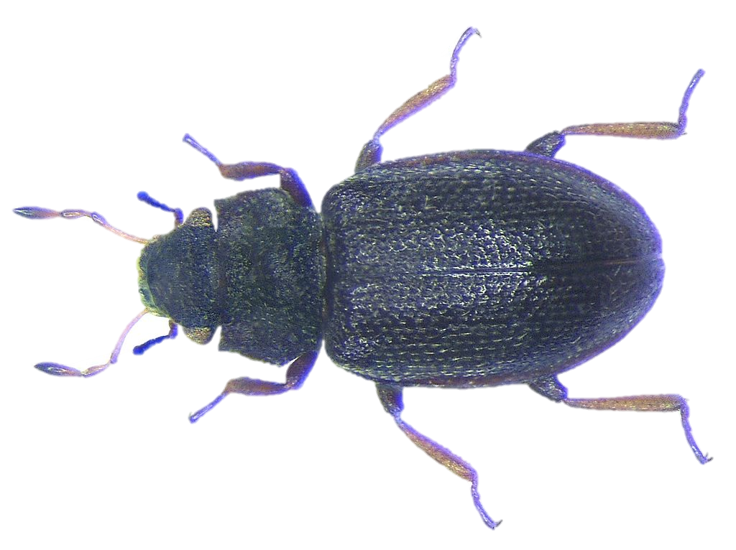
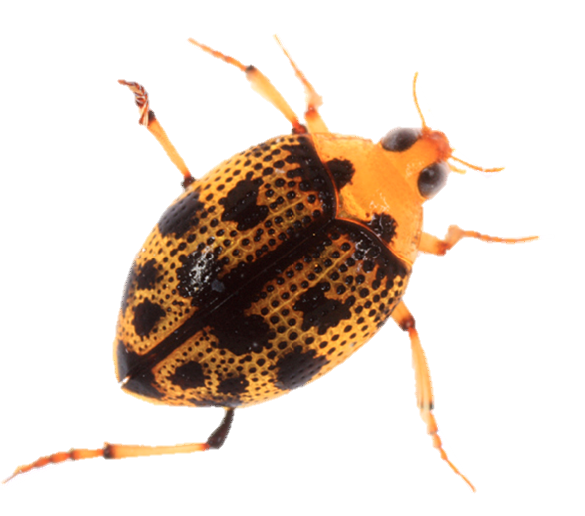
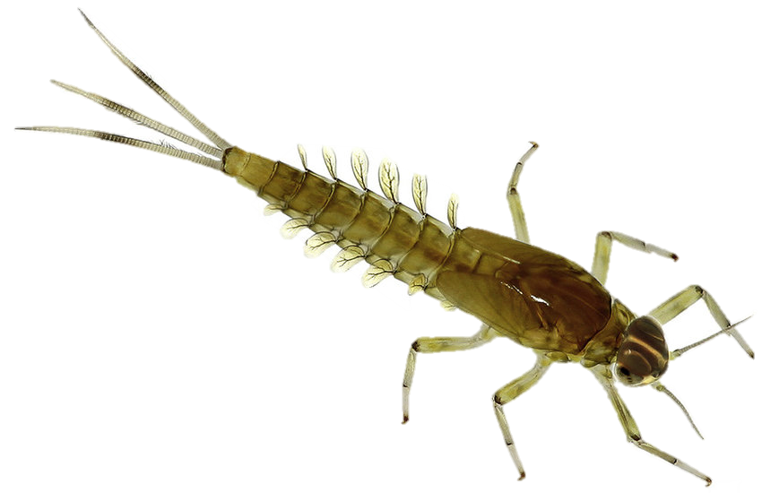
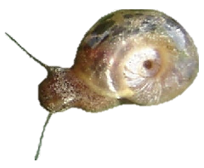
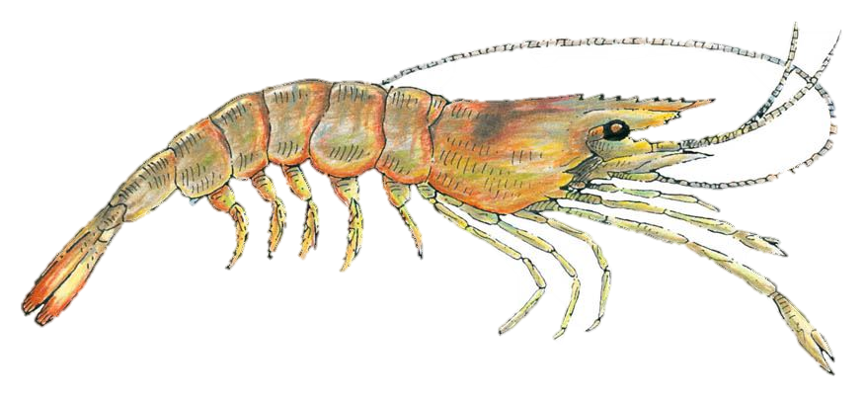
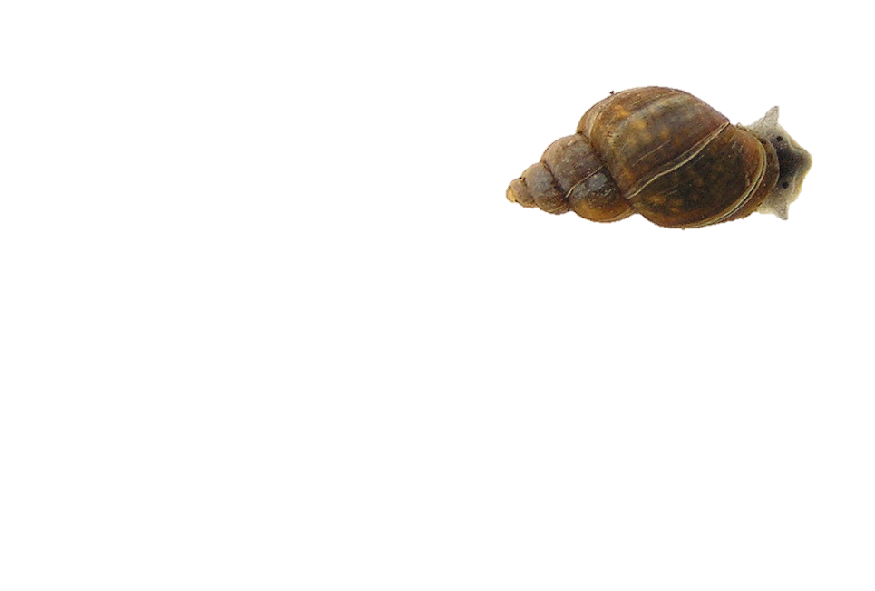
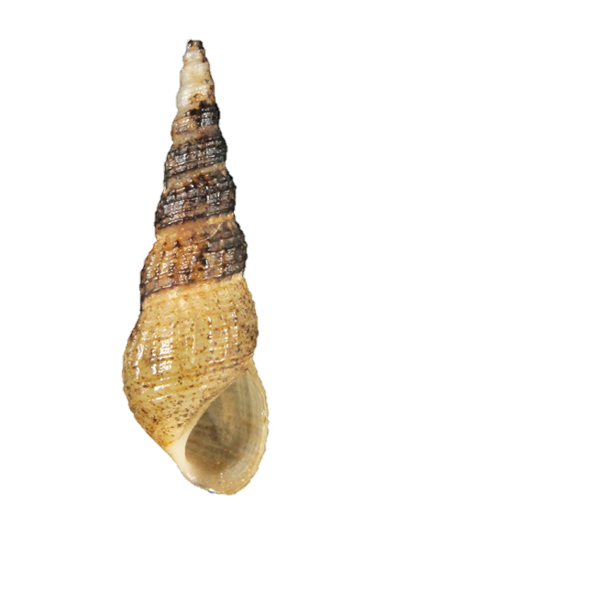
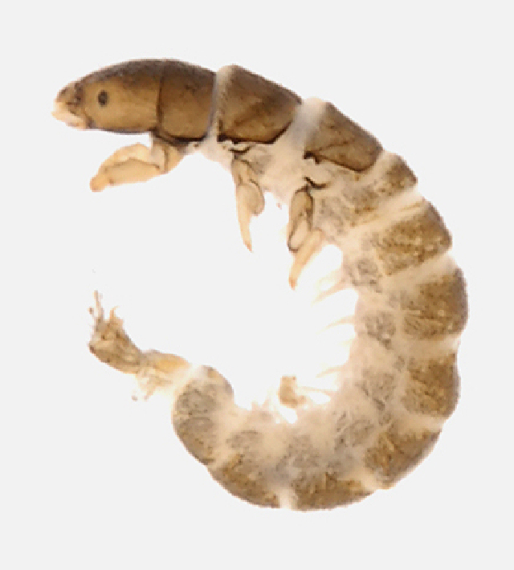
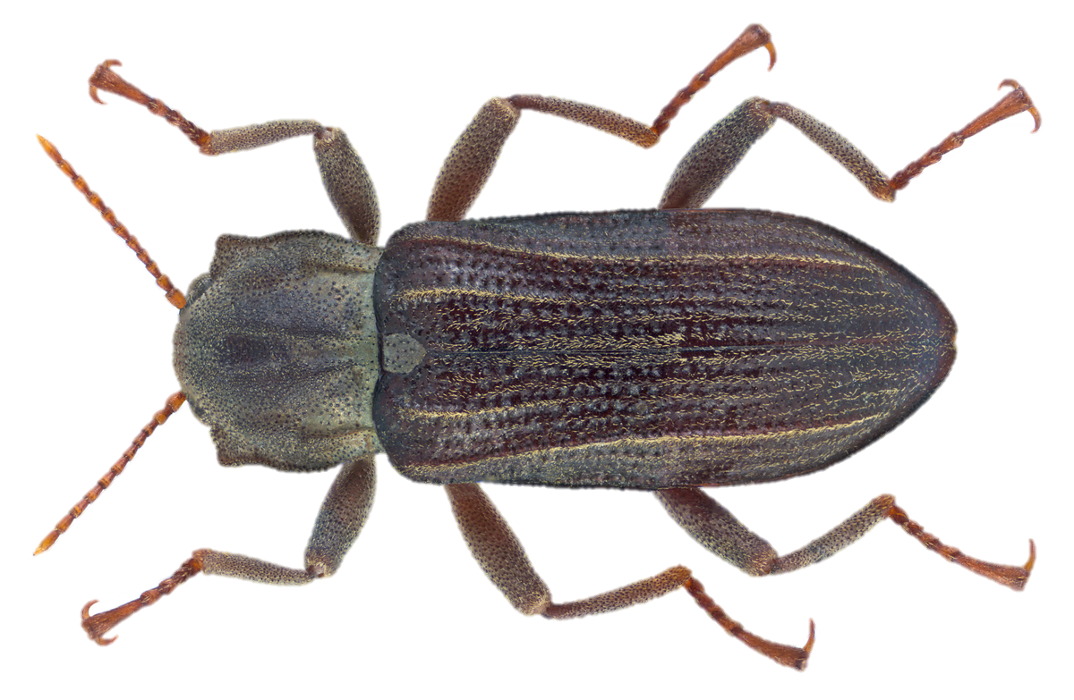
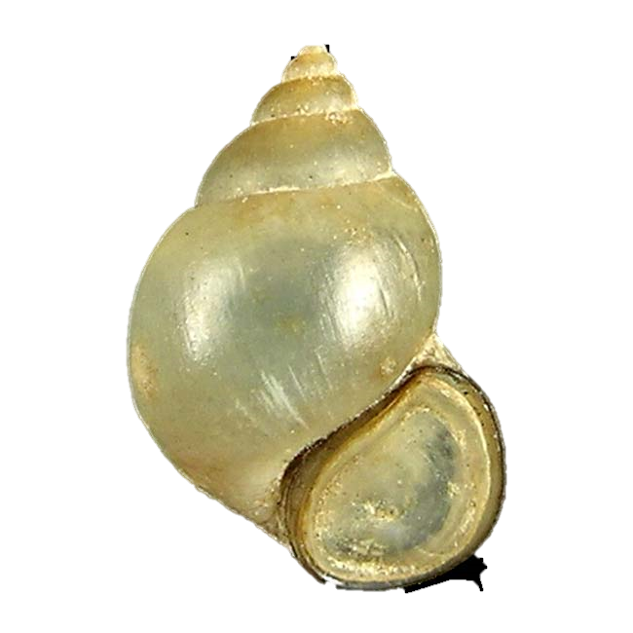
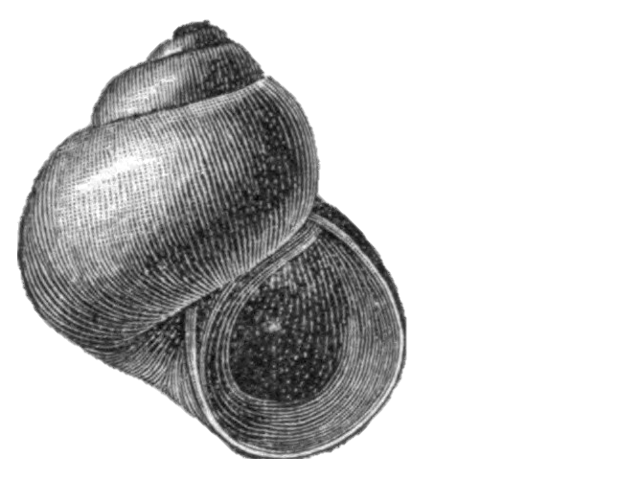
A
B
Hydraena
Peltodytes
Precipitation
(cm/yr)
Caenis
Channel Shape
Biomphalaria
Flashiness
Precipitation
Fossaria
Palaemonetes
Conductivity
Melanoides
Cheumatopsyche
Low Flow Pulse %
NH₄⁺
Stenelmis
Bythinia
Amnicola
Figure 3. (A) Invertebrate diversity plotted against annual precipitation (cm/yr) (B) Invertebrate community ordination using Hellinger transformation and redundancy analysis. Axes labels display the proportion of the variance explained as a percentage. Sites are represented by circles colored by annual precipitation indicated in the legend. Species are represented by red crosses, with species labels and reference images added to outer members. Environmental variables are shown in arrows and the significant ones are presented in red.

Slide 5
Response | Input | Slope | R² | F-stat | df | p-value | Multiple Regression
Shannon_{Fish} | Precipitation | 0.056 | 0.576 | 10.885 | 2 8 | 0.011* | + *
Shannon_{Fish} | Flashiness | 1.430 | 0.038 | 0.316 | 2 8 | 0.589 | +
Shannon_{Fish} | Channel Shape | 0.113 | 0.069 | 0.597 | 2 8 | 0.462 | +
Shannon_{Fish} | Low Flow Pulse % | -0.083 | 0.222 | 2.281 | 2 8 | 0.169 | -
Shannon_{Fish} | NH₄⁺ | -13.221 | 0.326 | 3.877 | 2 8 | 0.084 | -
Shannon_{Fish} | Conductivity | -0.920 | 0.413 | 5.636 | 2 8 | 0.045* | -
Shannon_{Invert} | Flashiness | 8.651 | 0.061 | 0.517 | 2 8 | 0.493 | +
Shannon_{Invert} | Precipitation | -0.085 | 0.057 | 0.487 | 2 8 | 0.505 | -
Shannon_{Invert} | Low Flow Pulse % | -0.489 | 0.336 | 4.056 | 2 8 | 0.079 | - *
Shannon_{Invert} | NH₄⁺ | -2.519 | 0.001 | 0.004 | 2 8 | 0.950 | -
Shannon_{Invert} | Conductivity | -0.884 | 0.017 | 0.135 | 2 8 | 0.723 | -
Shannon_{Invert} | Channel Shape | -0.899 | 0.193 | 1.917 | 2 8 | 0.204 | -
Table 1: Univariate regression summary statistics and multiple regression relationships predicting fish and invertebrate Shannon Index values using environmental predictors. * denotes a p-value < 0.05 or an Δ AICc < 2.

Slide 6
Environmental Feature | Mean | Interquartile Range
Precipitaiton (cm/yr) | 92.5 | 24.6
Mean Air Temperature (°C) | 21.1 | 0.3
Minimum Air Temperature (°C) | 15.1 | 0.4
Maximum Air Temperature (°C) | 27.5 | 0.8
Elevation (m) | 29.9 | 32.0
Average Basin Slope (%) | 0.7 | 0.8
Human Development (%) | 13.3 | 5.8
Planted Cropland (%) | 41.8 | 23.9
Average Clay Content (%) | 30.5 | 4.6
Average Silt Content (%) | 31.0 | 2.1
Average Sand Content (%) | 38.5 | 3.9
Supplemental Table 1: Mean and interquartile range values for environmental gradient features of 10 samples sites spanning the Texas Coastal Prairie. The source data was collected from US Geologic Surveyors Geospatial Attributes of Gages for Evaluating Streamflow, version II dataset (Falcone 2011).

Slide 7
Site Name | USGS Station ID | Precipitation (cm/yr) | Flashiness | Low Flow Pulse % | Channel Shape | NH₄⁺ (mg/L) | Conductivity ln(µS/cm)
San Fernando | 8211900 | 67.750 | 0.907 | 20.306 | 15.762 | 0.298 | 6.887
Tranquitas | 8212300 | 67.750 | 0.781 | 24.060 | 17.988 | 0.153 | 9.096
Medio | 8189300 | 79.130 | 0.993 | 0.000 | 18.405 | 0.113 | 6.748
Aransas | 8189700 | 80.770 | 1.053 | 7.664 | 11.781 | 0.105 | 6.835
Mission | 8189500 | 85.360 | 0.580 | 3.357 | 14.701 | 0.170 | 7.163
Perdido | 8177300 | 92.370 | 1.339 | 0.000 | 15.152 | 0.075 | 6.602
Garcitas | 8164600 | 102.410 | 0.806 | 4.867 | 18.161 | 0.098 | 6.249
Placedo | 8164800 | 104.650 | 0.921 | 5.482 | 13.380 | 0.088 | 7.035
Big Creek | 8115000 | 120.310 | 0.961 | 15.631 | 23.150 | 0.118 | 5.390
Bear Branch | 8068390 | 124.190 | 0.777 | 13.146 | 12.011 | 0.133 | 5.426
Supplemental Table 2: Environmental values for the 10 sample sites. Annual precipitation, flashiness, and Low-Flow Pulse % were calculated using 30-year records provided by USGS stream gauges. Channel shape (stream width / stream depth), NH₄⁺, and conductivity were measured in-situ in during Spring 2017 sampling.

Slide 8
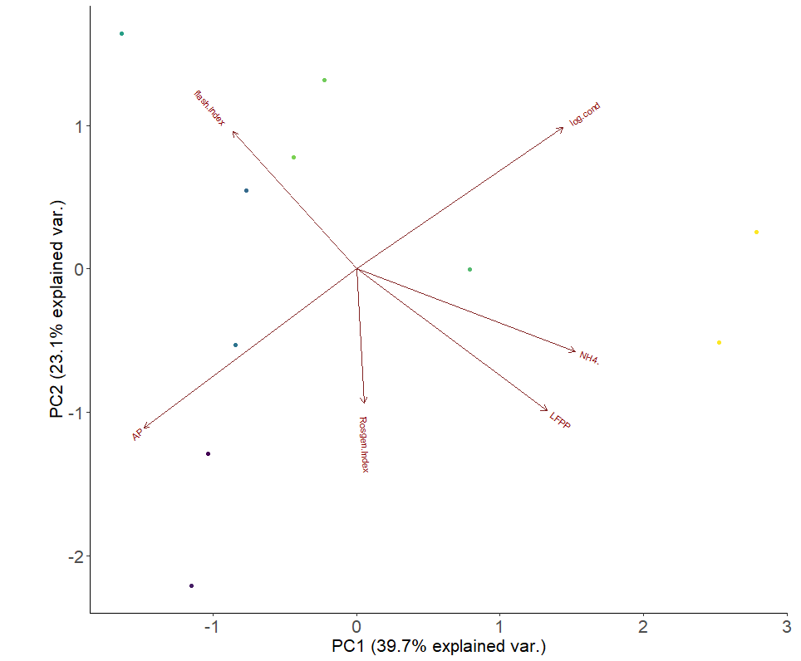
Flashiness
Conductivity
Supplemental Figure 1: Principal Component Analysis of environmental predictors at 10 sites spanning a precipitation gradient along the Texas Coastal Prairie. Circles representing sample sites are colored based on their annual precipitation. Axes labels include the percentage of variance explained by the first principal component (horizontal axis) and the second principal component (vertical axis).
PC1 (23.1%)
NH₄⁺
Precipitation
Channel Shape
Low Flow
Pulse %
PC1 (39.7%)

Slide 9
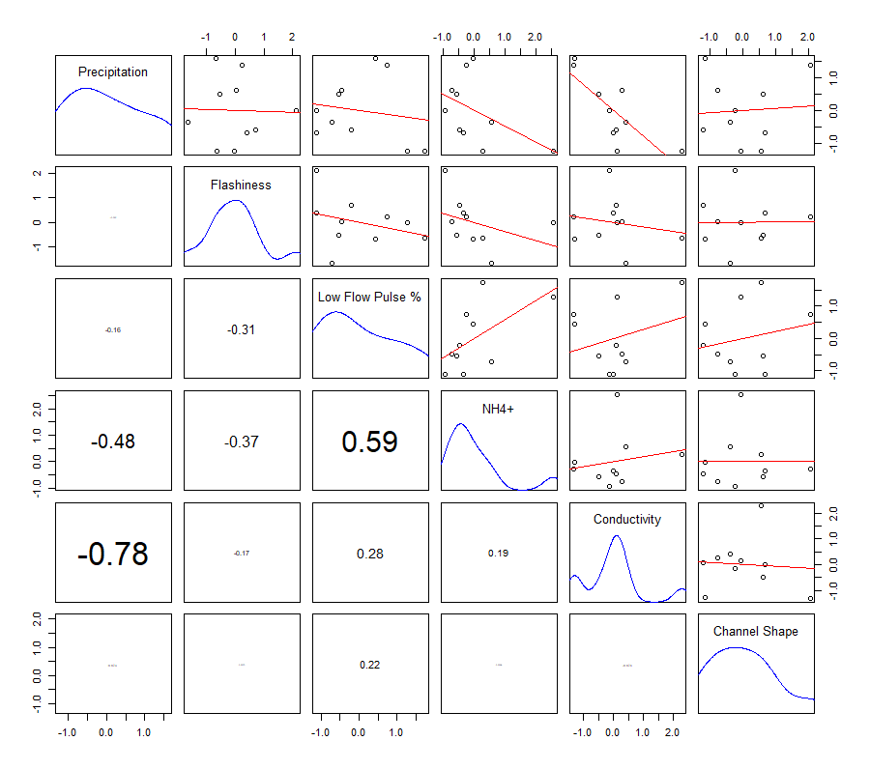
Supplemental Figure 2: Environmental predictors pairs plot. Scatter plots with linear regression are depicted in the upper right panels. Data point density is plotted by the blue line along the center diagonal panels. Correlation coefficients are scaled by magnitude and depicted in the lower left panels opposite of their complimentary scatterplot in the top right section.

Slide 10
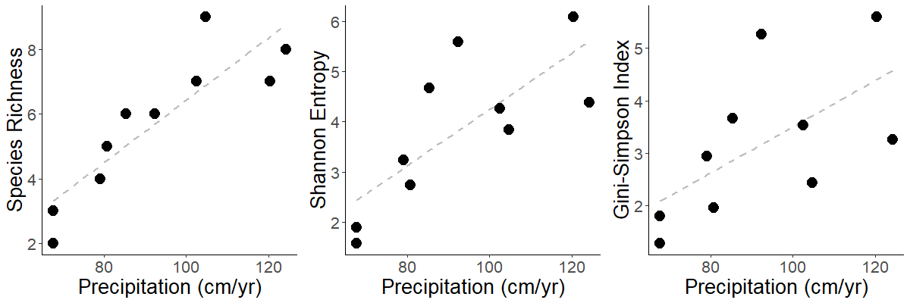
A
B
C
R² = 0.76
p = 0.00093
R² = 0.58
p = 0.011
R² = 0.39
p = 0.055
Supplemental Figure 3: Fish community (A) Species richness, (B) Shannon entropy, and (C) Gini-Simpson diversity plotted against annual precipitation. Dotted grey lines depict linear regressions and the associated correlation coefficients and p-values are printed in the lower right section of each panel.

Slide 11
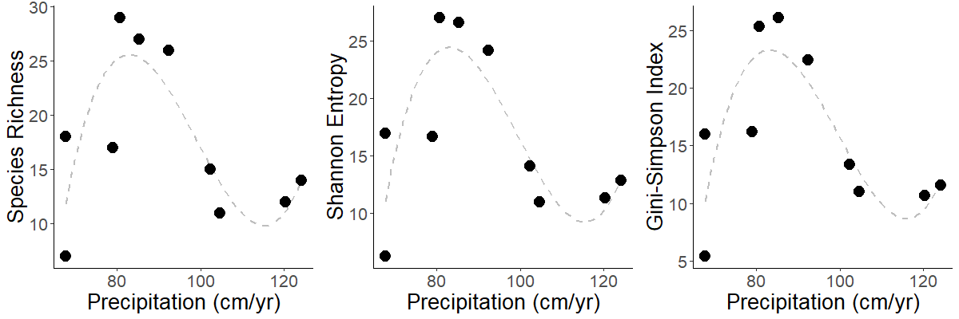
A
B
C
Supplemental Figure 4: Invertebrate community (A) Species richness, (B) Shannon entropy, and (C) Gini-Simpson diversity plotted against annual precipitation. Invertebrate biodiversity does not exhibit a straightforward linear relationship with annual precipitation, but the highest invertebrate diversity was observed at sites within the middle of the rainfall gradient.

